Slide 1
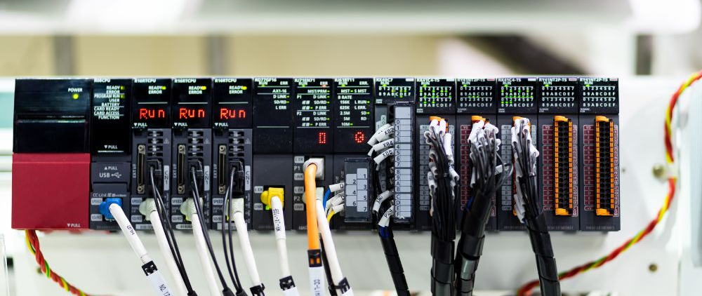
PLC Introduction
Akbar Q – Mechatronics Engineering Year 1 Semester 2

Slide 2
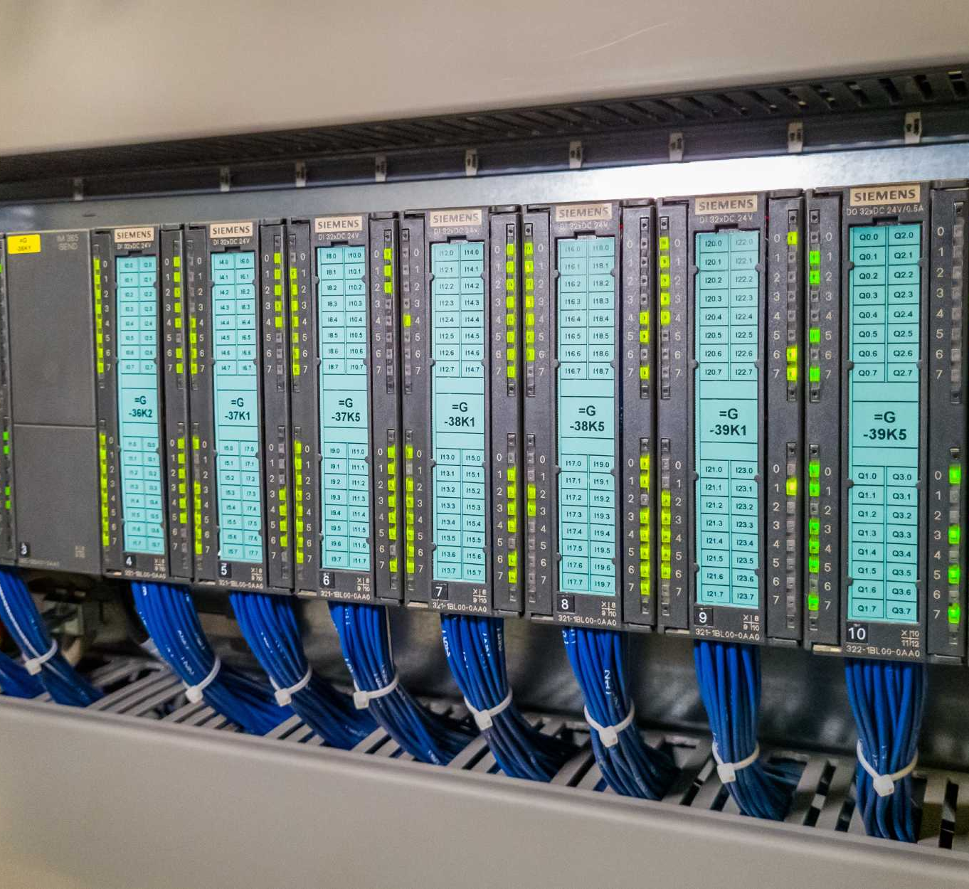
Core Definition
A digitally operating electronic system designed for industrial environments that uses programmable memory for internal storage of user-oriented instructions to implement specific functions such as logic, sequencing, timing, counting, and arithmetic

Slide 3

Key Characteristics
Industrial Hardening:
Conformal-coated PCBs resistant to humidity
Wide temperature range operation (-40°C to 70°C for some models)
DIN rail mounting with vibration resistance
Deterministic Operation:
Fixed scan cycle architecture
Watchdog timers for fault detection
<1ms I/O response times in high-speed applications
Modular Design:
Hot-swappable I/O modules
Fieldbus backplane communication (e.g., ControlNet, Profibus)

Slide 4
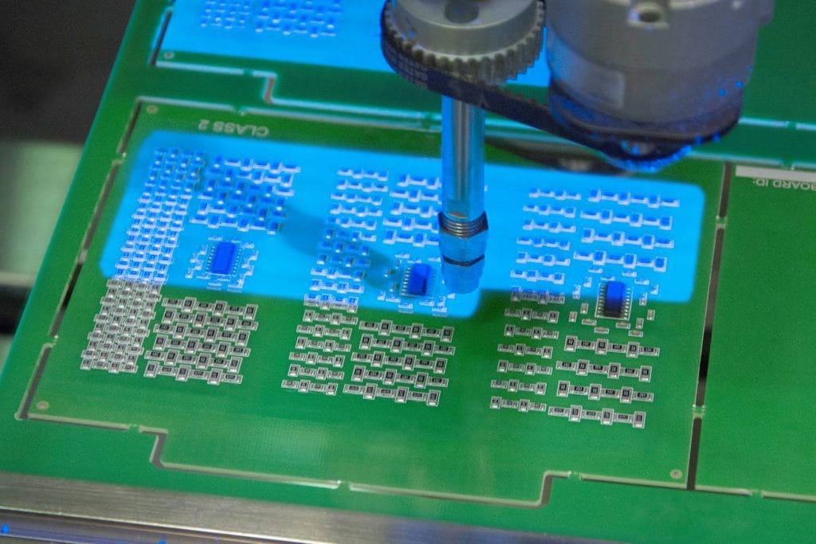

Slide 5
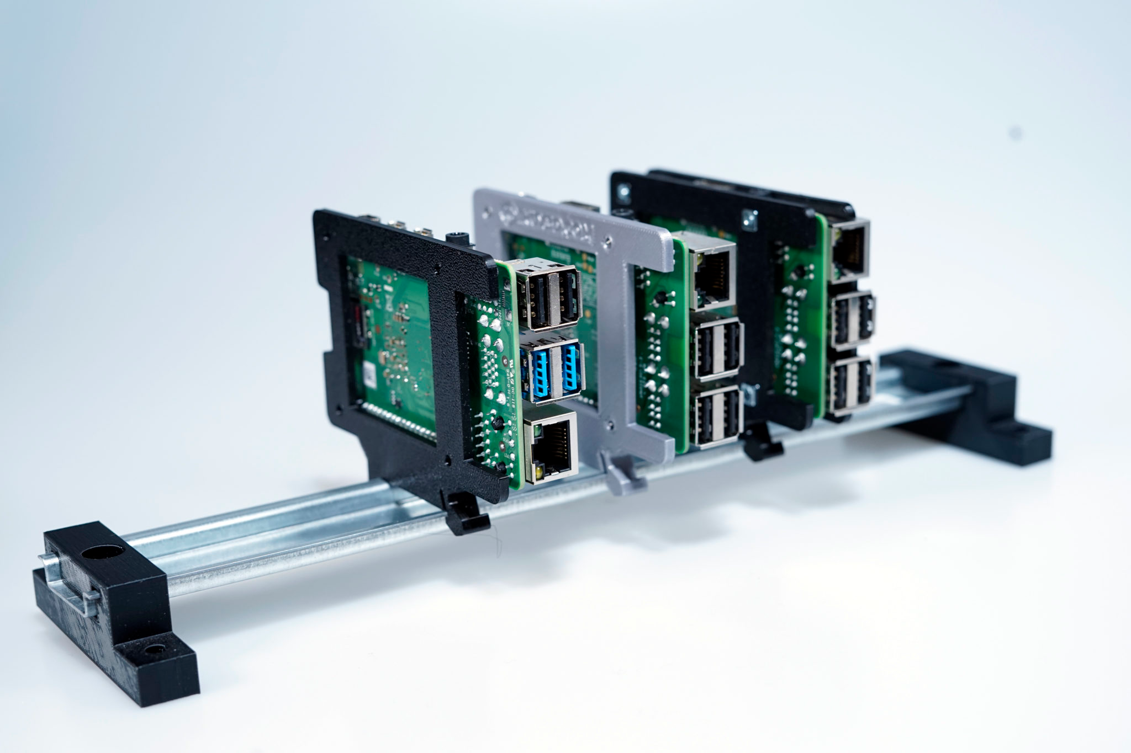

Slide 6
“An Evolution from relay panels to modern PLCs”
(1968 Bedford Associates Modicon)

Slide 7
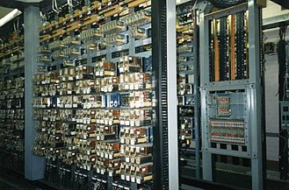

Slide 8
Relay Logic In Operation _______________________________ https://youtu.be/Ia4RV3JYWGg
Notes:
https://youtu.be/Ia4RV3JYWGg

Slide 9
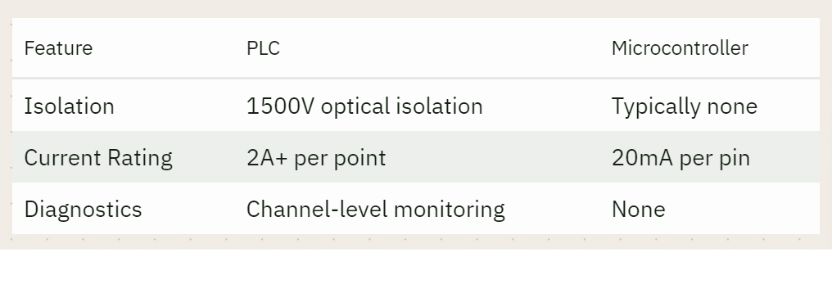
Microcontrollers vs PLCs - Technical Comparison

Slide 10
Processing Architecture
PLCs: Dedicated real-time OS (e.g., VxWorks)
MCUs: General-purpose OS (e.g., FreeRTOS) or bare metal
Memory
PLCs: ECC RAM with battery backup
MCUs: Non-ECC volatile memory
Use Case Decision
When to choose PLC: Need >50 I/O points, harsh environment, safety-critical
When to choose MCU: Prototyping, cost-sensitive, space-constrained

Slide 11
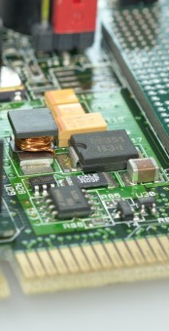
PLC Hardware
Processor Unit:
Dual/quad core CPUs (e.g., ARM Cortex-R series)
FPGA co-processors for high-speed logic
Battery-backed SRAM for program retention
Power Supply Design:
85-264VAC input range
24VDC output with <1% ripple
Redundant power supply configurations

Slide 12
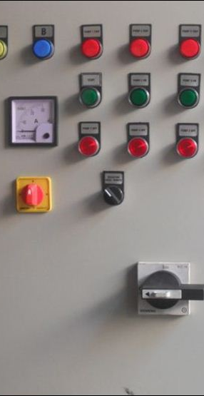
PLC Hardware
I/O Module:
Digital Input:
Wetting current requirements (2-5mA typical)
24V DC Typical Operation
Debounce filters (hardware and software)
Analog Input:
16-bit delta-sigma ADCs
Built-in signal conditioning (e.g., Siemens SM331)
0-10V DC and 4-20 mA Typical
This Photo by Unknown Author is licensed under CC BY-SA

Slide 13
4-20mA Input
Precision shunt resistor (250Ω ±0.1%)
Current-to-voltage conversion

Slide 15
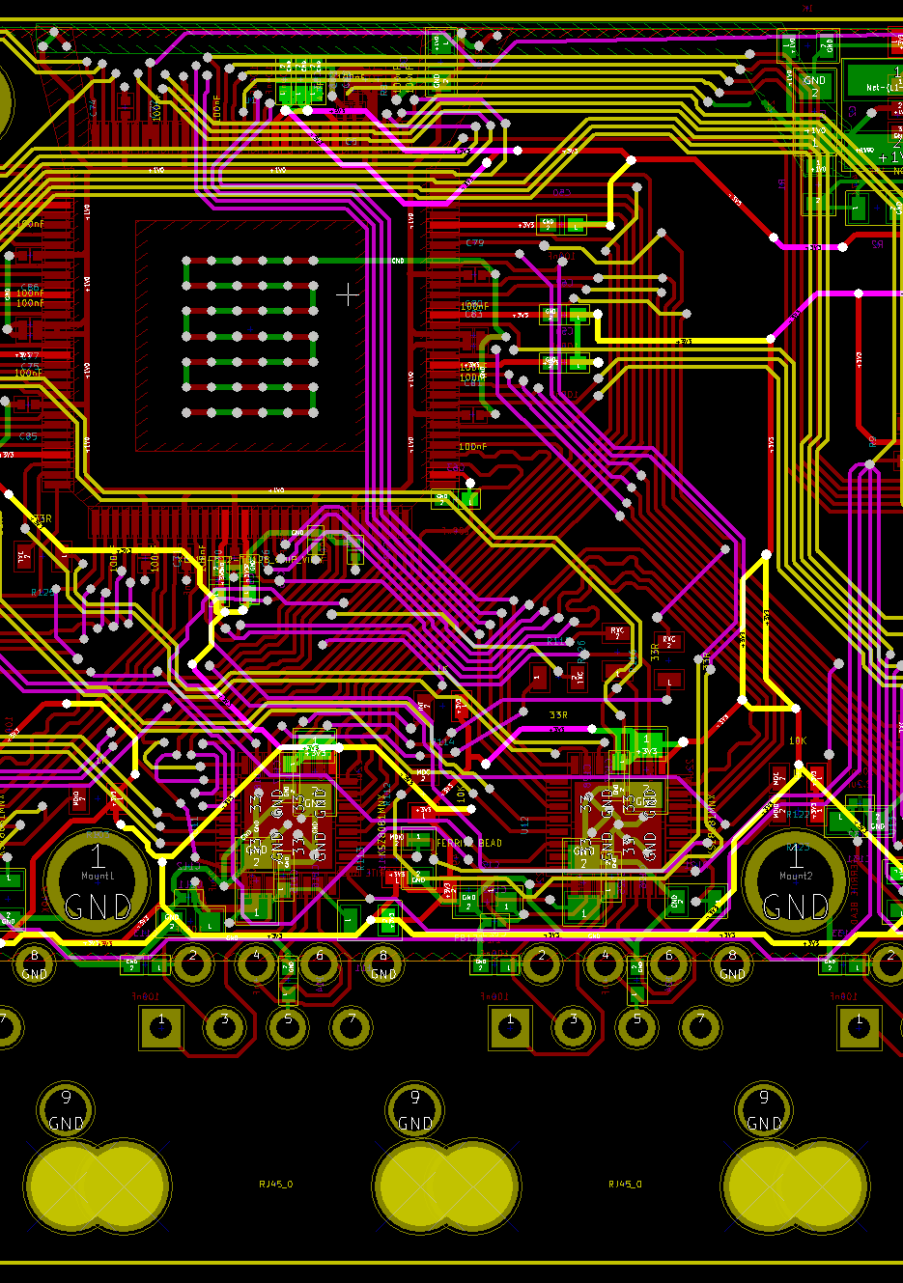
Digital Signal Path:
- Optical isolation (10kV/μs transient immunity)
- Schmitt trigger inputs
- Surge protection (TVS diodes)
Signal Integrity:
- Shielded twisted pair requirements
- Ground loop mitigation techniques
- Cable capacitance limitations

Slide 17
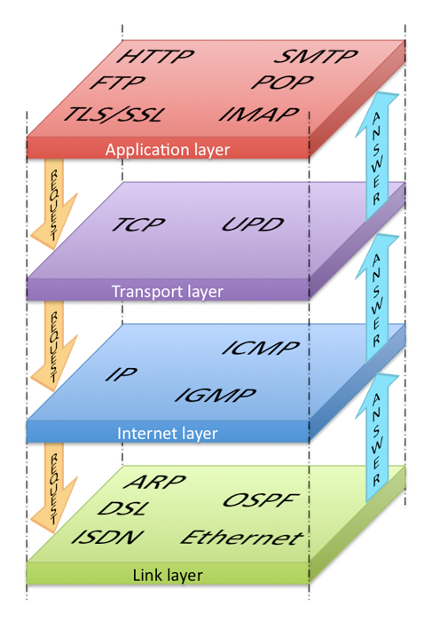
Protocol Stack Architecture:
Application Layer
-----------------
Presentation Layer
-----------------
Session Layer
-----------------
Transport Layer
-----------------
Network Layer
-----------------
Data Link Layer
-----------------
Physical Layer

Slide 18

PLC Programming

Slide 19
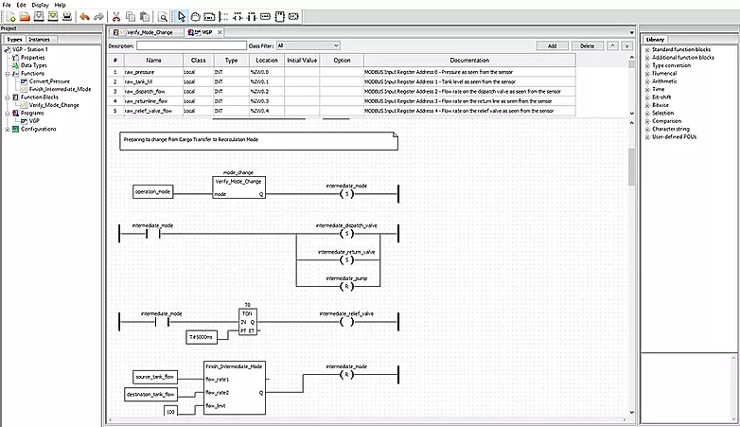
PLC Programming Environment

Slide 20
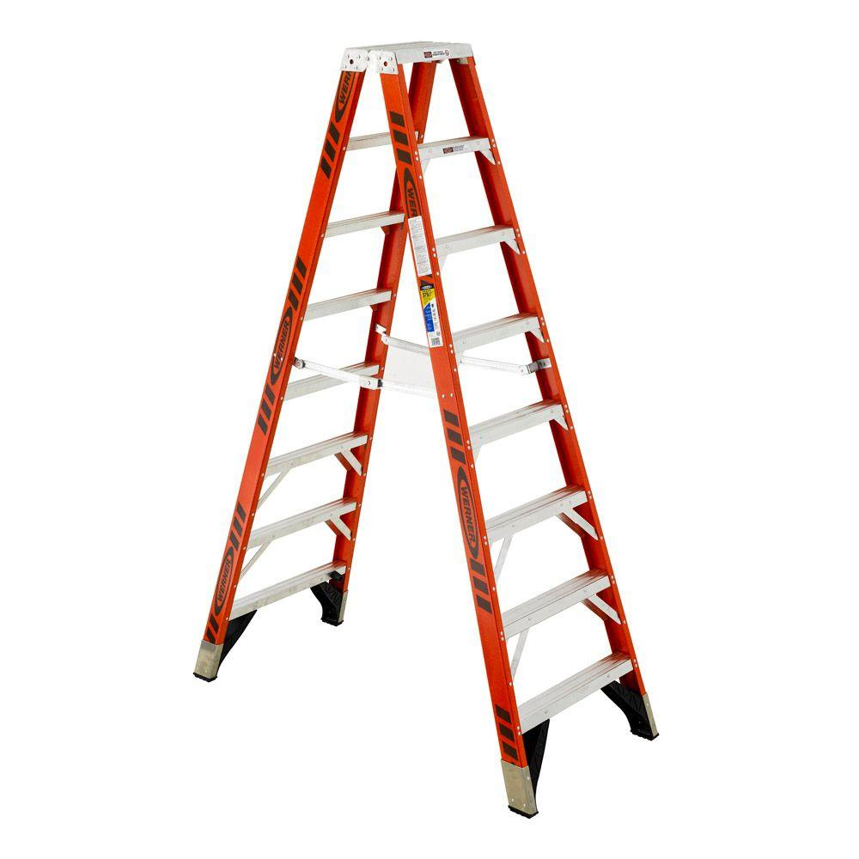
Practice Ladder Coding

Slide 21
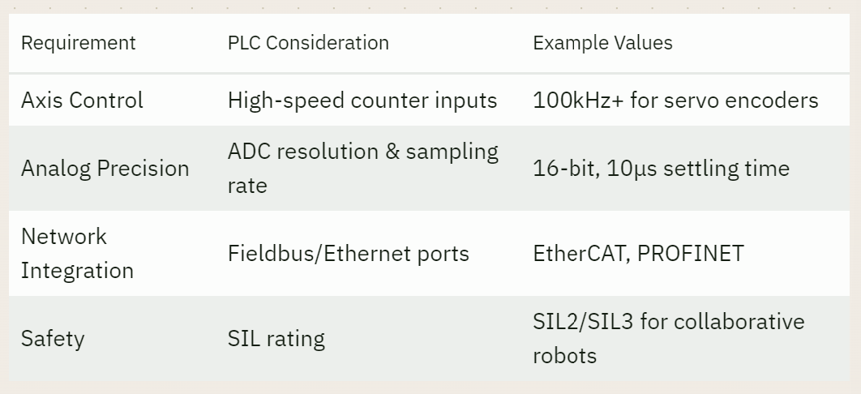
PLC Selection for Mechatronic Projects

Slide 22
Delivering with impact
Keeping your audience engaged through effective techniques

Slide 23
Delivering with confidence
Meaningful eye contact, purposeful gestures, and good posture can enhance your message and make it more memorable.

Slide 24
Conclusion
Start with a hook and a clear purpose. Engage your audience using eye contact, storytelling, and questions. Design slides that enhance your message, not distract. And deliver with confidence.

Slide 25

Q & A
How to handle audience questions effectively

